Slide 1
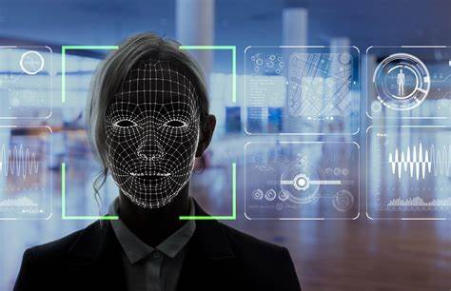
SIC IOT PROJECT UNIVERSITY OF LUCKNOW FACE DETECTION USING RASPBERRY PI
Submitted by-
Shivam Singh(ECE 4th)
(190013125050)
Saumya(ECE 4th)
(190013125047)
Jijeevisha Giri(ECE 4^{th)}
(190013125024)
Anamika singh(ECE 4th)
(190013135013)

Slide 2
Content
1) Abstract
2) Introduction
3) Components
4) Raspberry pi
5) How does it works

Slide 3
ABSTRACT-
in today’s world, face recognition is an important part for the purpose of security and surveillance. Hence there is a need for an efficient and cost effective system. Our goal is to explore the feasibility of implementing Raspberry Pi based face recognition system using conventional face detection and recognition techniques such as Haar detection and PCA. This paper aims at taking face recognition to a level in which the system can replace the use of passwords and RF I-Cards for access to high security systems and buildings. With the use of the Raspberry Pi kit, we aim at making the system cost effective and easy to use, with high performance

Slide 4
INTRODUCTION
The information age is quickly revolutionizing the way transactions are completed.
There is a need for a faster and accurate user identification and authentication
method. Face recognition has become one of the most important user identification methods. Literature survey statistics shows that research work in face recognition system is in its booming era, and in the past forty years, the research in this field has increased exponentially.
Face recognition technology emulates the capabilities of human eyes to detect
faces. This is done by smart computing that creates “face bunch” that consists of 70 nodal points. Features are extracted from the face and saved as templates. These templates are compared to the face detected. For this research, we interfaced an LCD, Camera and a Motor to the Raspberry Pi board. We have made a real time application, which compares the scans to records stored in the Raspberry Pi which in turn is used as a gate pass, wherein the name of the detected person is displayed on LCD and the motor will rotate
indicating opening and closing of the gate.

Slide 5
What You’ll Need for Raspberry Pi Face Mask Detection
Raspberry Pi 4 (Raspberry Pi Zero is not recommended for this project, and the Raspberry Pi 3 ran very slowly.)
16GB (or larger) microSD card (see best Raspberry Pi microSD cards) with a fresh install of Raspberry Pi OS Power
supply/Keyboard/Mouse/Monitor/HDMI Cable (for your Raspberry Pi)
USB Webcam or Raspberry Pi Camera
7-inch Raspberry Pi touchscreen

Slide 6
What is Raspberry Pi?
A Raspberry Pi is a single board computer (SBC) created in the United Kingdom by the Raspberry Pi Foundation. It's a charity that "works to put the power of computing and digital making into the hands of people all over the world."
The first model of the Raspberry Pi was released in 2012, and as of 2021 there have been five generations of the boards. A microcontroller (more about that later), called the Pico was released in early 2021.

Slide 7
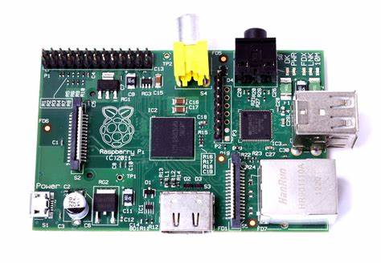

Slide 8
GPIO Pins-
Something that sets the Pi apart from your average computer is the set of 40 GPIO (General Purpose Input Output) pins.
GPIO pins are pretty much exactly what they sound like. They are designed to input and output single bits. This means that you can use them to add all sorts of functionality to your Raspberry Pi using switches, buzzers, lights, sensors, and so on.

Slide 9
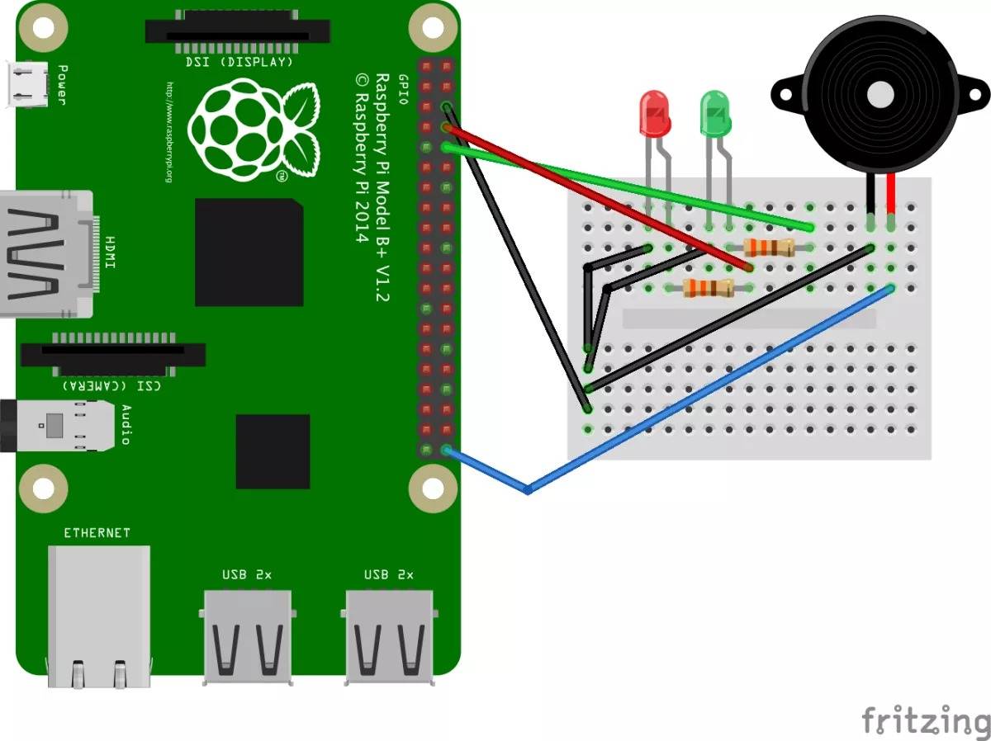

Slide 10
Raspberry Pi Operating Systems-
The Raspberry Pi often runs some form of Linux, but there are a ton of operating systems that you can use.
On the official website, you will find a list of operating system images available for download. These include the official Raspberry Pi OS, Debian Buster, and Ubuntu (desktop, core, and server.)
You will also find RetroPie, a specialized gaming platform operating system, and LibreELEC, a lightweight Linux distribution specifically created for use with the open source media player Kodi.

Slide 11
Raspberry Pi VS Arduino-
You may have heard of Arduino boards and wondered what the difference is between them and the Raspberry Pi.
The main difference is that Pis (with the exception of the Pico and the RP2040) are full computers with operating systems. You can connect your Pi to a keyboard, mouse, and monitor and use it like you would use a Mac or PC.
The Arduino, on the other hand, is a microcontroller. It cannot function independently as a computer, but is programmed using a computer and then used to control things like cameras, lights, robots, and so on.
As the official Arduino website puts it: “Arduino boards are able to read inputs… and turn it into an output.”

Slide 12
How does it work
Face Mask Model Training (Long Method) Now that you have your face mask detector up and running, you’re probably wondering, “How does it work?” Over one thousand photos were used to train the model that detect_mask_webcam.py uses to make the mask or no mask determination. The more examples provided, the better the machine learning because fewer photos = less accuracy. Photos were divided into 2 folders in our dataset, with_mask and without_mask and the training algorithm created a model of mask vs. no mask based on the dataset. The sample photos provided in the dataset folder you downloaded from GitHub are my own photos. What if instead of hundreds of photos, we trained our Raspberry Pi Mask Detection system on 20 photos? Fortunately, we have a pre-trained model for you to test out.From your face_mask_detection folder in your terminal, run the Python 3 code to open up your webcam with the 20 photo model. python3 detect_mask_webcam.py --model mask_detector-20.modelIf you are using a Pi Camera, enter python3 detect_mask_picam.py --model mask_detector-20.modelAfter a few seconds, you should see your camera view pop-up window and see a green box or a red box. You’ll find this model is not very accurate.

Slide 13
Thank you
!!

